Slide 1
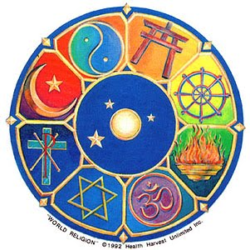
Religion
Intro

Slide 2
True or False
1. There are 3 main religions.
2. Religion is not important in Europe’s history.
3. The religions have nothing in common.
4. The religions are different in their beliefs.
5. There are never disagreements about religion.

Slide 3
6. Most Europeans have the freedom to choose their religion.
7. There can be disagreements between people of the same religion.
8. Wars have been fought over religion.

Slide 4
9. Europeans do not respect the rights of people to choose their own religion.
10. Government leaders have been changed because of religion.

Slide 5
Religion is an important part of culture.
It is a system of worship and belief, including belief about the nature of a god or gods.

Slide 6
It can help guide people in matters of ethics, or standards of acceptable behavior.
All religions have prayers and rituals.
Followers observe religious holidays.

Slide 7
The world has many religions.

Slide 8
Some religions believe that there is only one god, this is called monotheism.
Some religions believe in many gods, this is called polytheism.

Slide 9
Judaism

Slide 10
Christianity

Slide 11
Islam

Slide 12
Mystery Word #1
Clue #1
one
monotheism

Slide 13
Mystery Word #2
Clue #1
many
Clue #2
part of culture
religion

