Slide 1
Literacy Rate
and
Standard of Living

Slide 2
Literacy Rate:
What is it?
The percentage (%) of people who can read and write.
Why is it important?
If a country improves its literacy rate, it also improves its economy and standard of living.

Slide 4
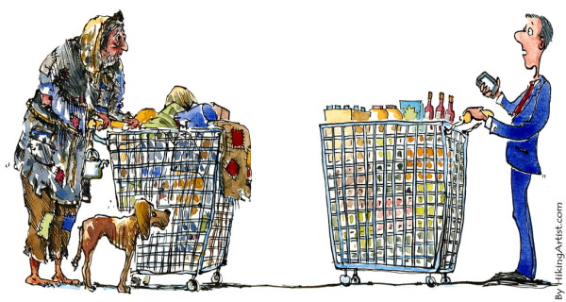
Standard of Living:
What is it?
A measure (either high or low) of the quality of life based on income and education of a country’s population.

Slide 5
Standard of Living:
What affects it?
Food, housing, transportation, technology, education, health care
What does it tell us?
How well or how poorly a person/group of people live

Slide 7
Unscramble:
ERLYCAIT 4. TIEWR
AEDUICOTN 5. IMECON
ARED 6. VLINIG

