Slide 1
Judaism

Slide 2
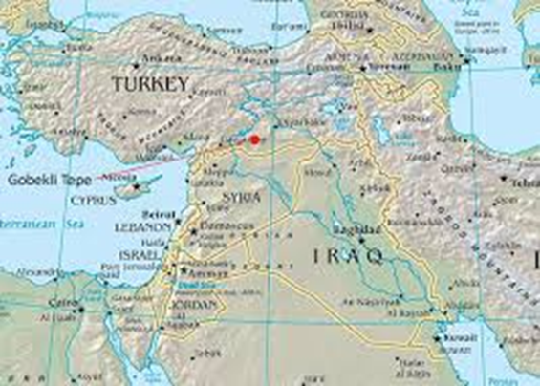
Belief – believe in only one God
Leader – Abraham
Started – 2000 BC in SW Asia

Slide 3
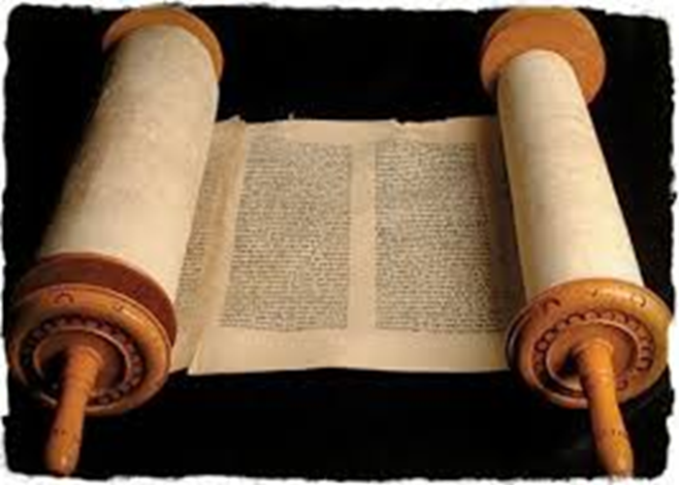
Name of God – Yahweh
Sacred Text - Torah

Slide 4
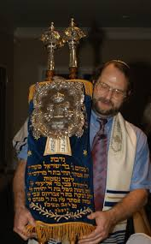
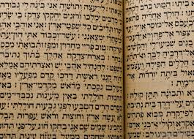
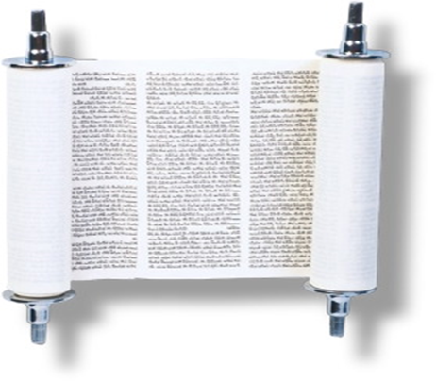

Slide 5
Followers called – Jews
# of Followers – about 1.4 million
Sacred building - synagogue

Slide 6
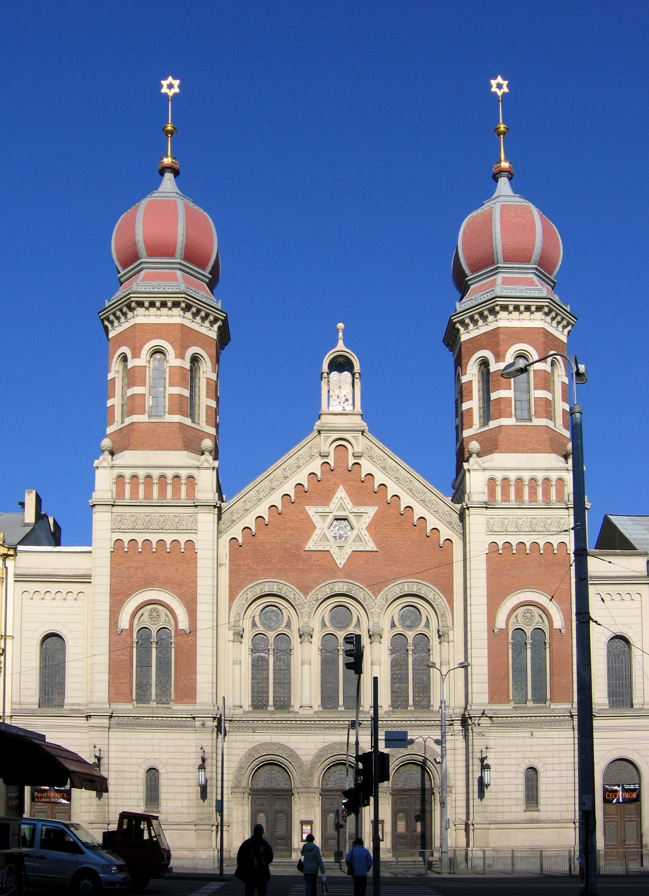

Slide 7
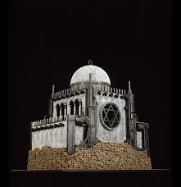
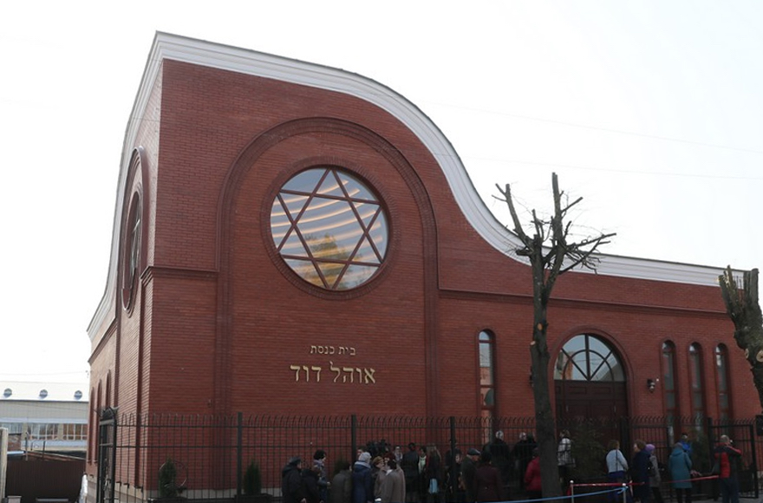

Slide 10
What happened to leader – lived a very
long life (175 years)

Slide 11
Major groups: 1. Orthodox – most traditional
2. Conservative
3. Reform – least traditional

Slide 12
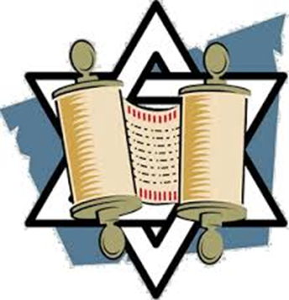
Fun Fact - foundation of Christianity,
Islam, others

Slide 13
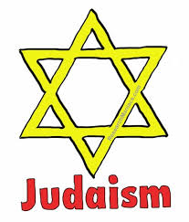
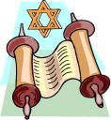
Judaism Questions
Answers only!!!!

Slide 14
What is the name of their God?
The Jewish sacred text is called a ____.
What is the name of their sacred building?
The leader of Judaism was _______.

Slide 15
5. Their leader lived to be ____ years old.
6. Where and when did Judaism start?
7. Do they believe in 1 god or many gods?
8. There are _________ followers of Judaism in Europe.

Slide 16
9. Judaism is the _____ of Christianity,
Islam, and other religions.
10. What are the 3 main groups called?

Slide 17
Closing – “2 things”
What are 2 things you learned today about Judaism???
Write your 2 things on your post-it and post it on the wall on your way out. You must include your name!!

