Slide 1
Cuba chart notes

Slide 2
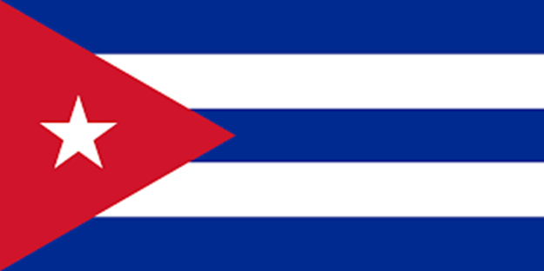
Cuba

Slide 3
- became independent in 1902
- have had many leaders/dictators
- wealthy country but most people
were poor and unhappy with the
government and the command
economy

Slide 4
Questions about notes – answers only

Slide 5
When did Cuba become an independent country?
Although the country was wealthy, most people were _________.

Slide 6
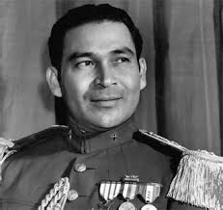
Fulgencio Batista
- 1939 – elected President, later
became dictator
- corrupt, most people unhappy,
lots of problems

Slide 7
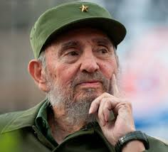
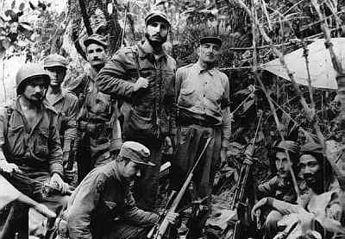
Cuban Revolution
- group of rebels led by Fidel Castro
won battles against Batista’s
government

Slide 8
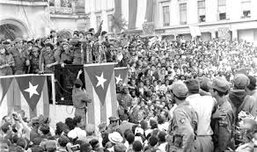
- forced Batista to flee and Castro took over in 1959

Slide 9
Questions about notes – answers only

Slide 10
3. Who was elected president in 1939?
4. Which was NOT true while Batista was president?
A. people were unhappy
B. government was corrupt
C. most people were happy
D. lots of problems

Slide 11
5. Who took over in 1959?
6. How did Castro take over?
A. won battles over Batista’s gov.
B. forced Batista to flee Cuba
C. both of these
D. none of these

Slide 12
Video questions – copy

Slide 13
July 26, 1953 – how many men?
what happened to Castro?
county he goes to?
Nov. 26, 1956 – how long in mtns?
5. 2 things Batista does to people?
6. what holiday when Batista leaves?
7. what happens during Castro’s speech?
8. good sign or bad sign?

Slide 14
https://www.history.com/topics/cold-war/castro-and-the-cuban-revolution-video

Slide 15
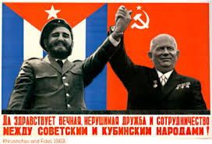
Fidel Castro
- after taking control, he sided with
Soviet Union during Cold War and
they traded goods and weapons

Slide 16
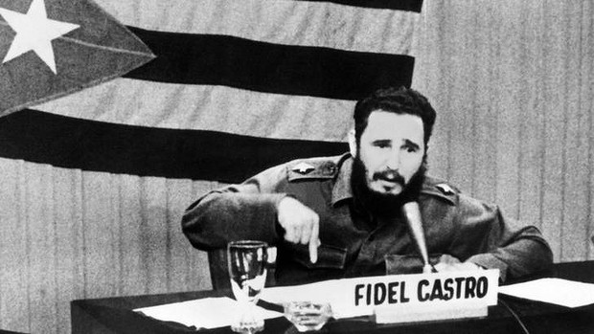
he made Cuba communist like the Soviet Union and he controlled everything, making it an autocratic government

Slide 17
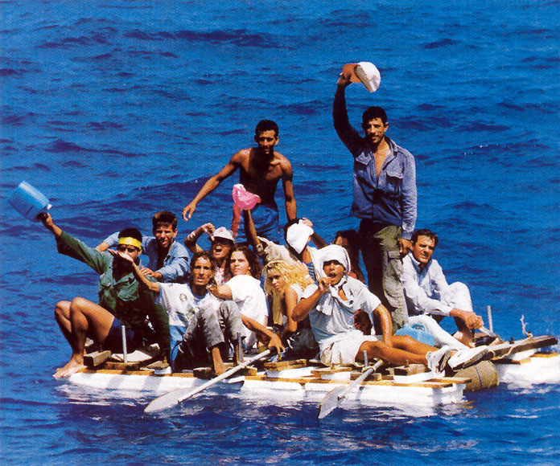
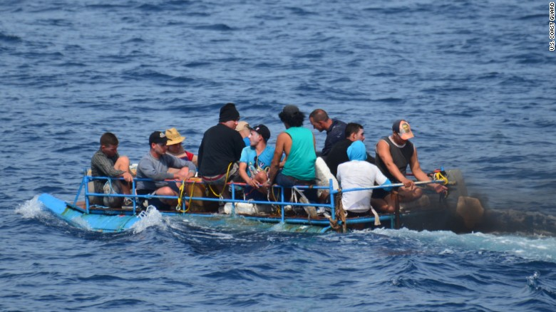
many were not happy and they left Cuba and fled to the United States

Slide 18
1961 – US cut all ties with Cuba and
relations between the two countries were tense
Cuba struggled, especially
when the Soviet Union fell apart

Slide 19
Questions about notes – answers only

Slide 20
7. Who did Castro side with after he took control?
8. Because many Cubans were not happy, what did they do?
9. When did the US cut all ties with Cuba?

Slide 21
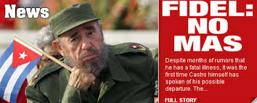
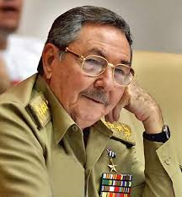
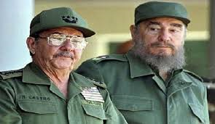
Cuba today
-Fidel resigned due to illness and
his brother Raul took over in 2008,
Fidel died November 25, 2016

Slide 22
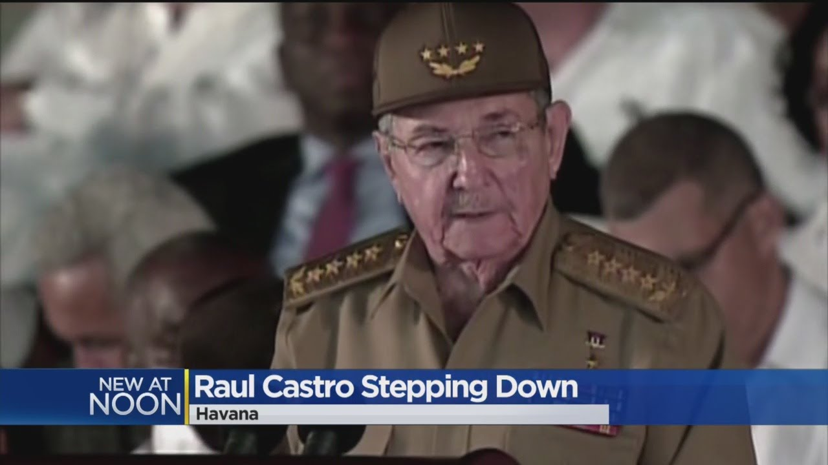
on April 19, 2018, Raul stepped
down as president

Slide 23
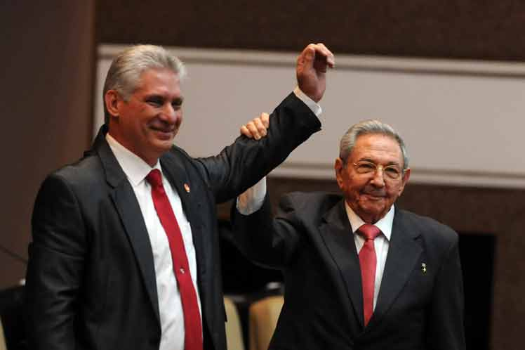
Miguel Diaz-Canel took over as
president, the first time in 6
decades the president is not a
member of the Castro family

Slide 24
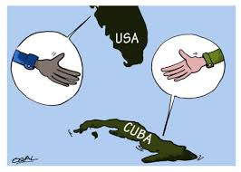
relations between the United States and Cuba have changed but the US still has an embargo on Cuba

Slide 26
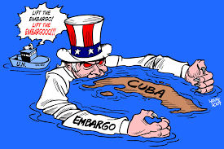

Slide 27
Questions about notes – answers only

Slide 28
10. Why did Fidel resign?
11. Who took over?
12. What happened in Nov. 2016?
13. Who is the president of Cuba today?

Slide 29
14. Summary Sentence:
Two things I learned about Cuba’s history are ________ and _______.

