Slide 1
Christianity

Slide 2
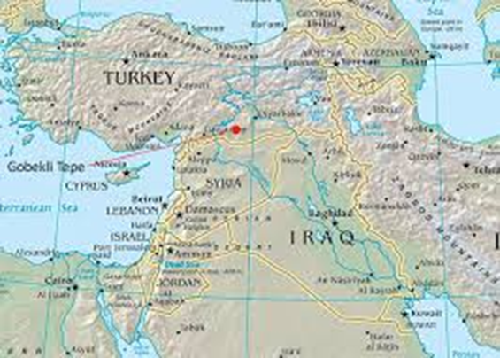
Belief – believe in only one God
Leader – Jesus Christ
Started – 30 AD in SW Asia

Slide 3
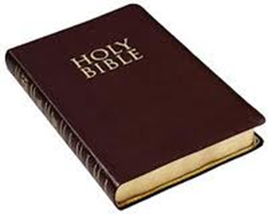
Name of God – God
Sacred text – Bible

Slide 4
Followers called – Christians
# of Followers – about 553 million
Sacred building - Church

Slide 8
What happened to leader – authorities
wanted to get rid of him, he was arrested
and died(33)

Slide 9
Major Groups-1. Eastern Orthodox
2. Roman Catholic
3. Protestant – includes Baptists,
Methodists, Presbyterians,
others
Fun fact – most dominant religion in Europe

Slide 10
Christianity Classwork
Answers only!!!

Slide 11
What is their sacred text?
There are ____followers in Europe.
Followers of Christianity are called___.
4. Do they believe in 1 god or many gods?

Slide 12
5. The leader of Christianity was _____.
6. Where and when did Christianity start?
7. Christianity is the most ___ religion in
Europe.

Slide 13
8. The leader was __ and died when he
was ___ years old.
9. What is their sacred building?
10. Name the 3 major groups.

