Slide 1
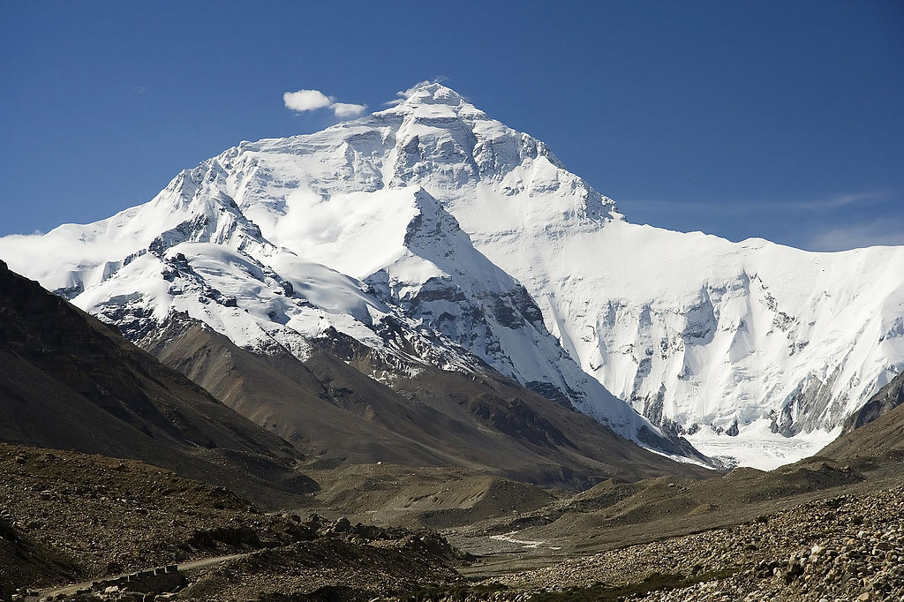
Chapter 12:
Geography and History of Southern and Eastern Asia
STUDY PRESENTATION
© 2017 Clairmont Press

Slide 2
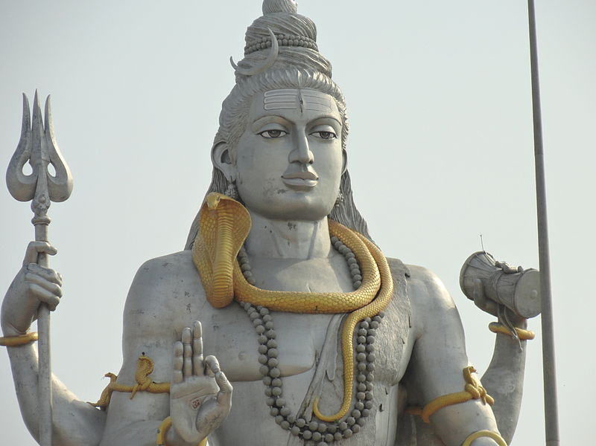
Section 1: The Geography of Southern and Eastern Asia
Section 2: The People of Asia
Section 3: A Brief History of Southern and Eastern Asia

Slide 3
Section 1: The Geography of Southern and Eastern Asia
Essential Question:
How does the geography of Southern and Eastern Asia affect where and how people live?

Slide 4
Section 1: The Geography of Southern and Eastern Asia
What terms do I need to know?
subcontinent
tectonic plate
archipelago
peninsula

Slide 5
Location of the Countries of Southern and Eastern Asia
Twenty-nine countries make up the vast region of Southern and Eastern Asia.
The countries very greatly in geography, cultures, and politics.
Different geographic features tend to separate Asian countries.
The Sea of Japan, for example, separates the Korean Peninsula from the country of Japan. Japan is an archipelago, which means it is made of a chain of islands.
India is a subcontinent, which means it is a large land area that is mostly separate from the rest of Asia. It is also on a different tectonic plate, a separate area of Earth’s crust, than most of the rest of Asia.

Slide 6
Physical Features of Asia
Physical geography impacts the way people trade, travel, live, and work.
The influence of mountains, rivers, deserts, and large bodies of water all contribute to how people satisfy their needs and wants.
Southern and Eastern Asia are home to many of the longest rivers in the world, like the Ganges River, the Chang Jiang (Yangtze) River, and the Huang He (Yellow) River.
The Himalayan Mountains are the tallest mountain range in the world, with Mount Everest as its highest peak.
The Taklamakan Desert in western China and the Gobi Desert in northern China are among the largest in the world.
The Sea of Japan and the South China Sea are two of the larger bodies of water in Southern and Eastern Asia.

Slide 7
Impact of Geography on Where People Live and How They Trade
Asia’s diverse geography and location of natural resources heavily impact where people live and how they trade.
India is separated from the rest of Asia by mountains. Most of India’s population lives in river valleys south of the Himalayas. The rivers provide water for irrigation, travel, trade routes, and drinking water.
China’s population is more concentrated around its rivers, opposed to its mountain and desert regions, because of the rivers’ resources.
In North Korea and South Korea, geography and politics influence the trade success of the countries. The countries make up a peninsula, which is a landform surrounded on three sides by water.
As an island nation with few natural resources, Japan relies on trade by sea and air to meet the needs and wants of its people.
Return to Main Menu

Slide 8
Section 2: The People of Asia
Essential Question:
What are differences between ethnic groups and religious groups in Asia?

Slide 9
Section 2: The People of Asia
What terms do I need to know?
ethnic group
religious group
philosophy
Hinduism
Vedas
Brahman
reincarnation
karma
caste system
Buddhism
Four Noble Truths
nirvana
Middle Way
Tripitaka
Mahayana Sutras
Shinto
kami
Confucianism
Golden Rule of Behavior

Slide 10
Ethnic and Religious Groups in Asia
An ethnic group refers to a group of people who share cultural ideas and beliefs that have been a part of their community for many years.
Features of this group can include language, religion, history, types of food, and a set of traditional stories, beliefs, or celebrations.
A religious group refers to a group of people who share a belief system in a god or gods with a specific set of rituals and literature.
The four main ethnic and religious groups in Asia include Hinduism, Buddhism, Shinto, and Confucianism.
Hinduism, Buddhism, and Shinto are religions native to Southern and Eastern Asia.
China is the birthplace of Confucianism, which is not a religion, but rather a philosophy, based on morality and good deeds.

Slide 11
Ethnic and Religious Groups in Asia
Hinduism is one of the oldest religions in the world and was founded in India around 1500 BC. Aryan priests followed complicated rituals and hymns known as the Vedas.
There is no specific founder for Hinduism, unlike other religions. Followers of Hinduism are called Hindus.
Many gods and goddesses exist in Hinduism, but it is believed that they are all part of a supreme “universal spirit” named Brahman.
The Ganges River is a holy river for Hindus, and several religious practices involve the river.

Slide 12
Ethnic and Religious Groups in Asia
Reincarnation is the religious belief that when a person dies, their soul is reborn into a person or animal according. This is based on his or her good or bad deeds, or karma.
The caste system, a system of social classes that are inherited and cannot be changed, acts an important religious and social influence for Hindus.
The traditional castes include Brahmans, Kshatriyas, Vaishyas, and Sudras.
Over time, the castes have been further divided, complicating the structure of India’s social structure.

Slide 13
Ethnic and Religious Groups in Asia
Buddhism was founded by Siddhartha Gautama around 500 BC.
Siddhartha sought answers as to why there is so much suffering in the world. After meditation, Siddhartha became known and “Buddha” or “The Enlightened One.” He believed the cause of human suffering to be greed and the desire for material things.
The central teaching of Buddhism is called the Four Noble Truths, which include moral “truths” and instructions for conduct. The Tripitaka and the Mahayana Sutras make up two Buddhist texts.
Nirvana exists as a state of perfect peace for Buddhists. It can be reached by following the Middle Way, via rules outlined by the Eightfold Path.

Slide 14
Ethnic and Religious Groups in Asia
Shinto is a religion unique to Japan, with no specific date of origin or founder. It is closely intertwined with Japanese culture.
The main belief of Shinto is reverence for the kami, which are spirits that Shinto followers believe live in nature, animals, and a person’s ancestors.
Followers offer prayers and perform rituals to honor and please the kami.

Slide 15
Ethnic and Religious Groups in Asia
Confucianism was founded by a Chinese scholar named Confucius around 550 BC.
Confucius emphasized good character and virtue as a means to peace and social order.
The Golden Rule of Behavior says, “What you do not like when done unto you, do not do to others.”
Confucius believed that his philosophy would bring order to China, should leaders and the government follow Confucianism’s guiding principles.
Even though China is now a communist country, the Chinese and many people throughout Southern and Eastern Asia continue to respect and practice Confucianism teachings.
Return to Main Menu

Slide 16
Section 3: A Brief History of Southern and Eastern Asia
Essential Question:
How did the events of World War II impact Asia politically and socially?

Slide 17
Section 3: A Brief History of Southern and Eastern Asia
What terms do I need to know?
Cold War
containment
cease-fire
domino theory
demilitarized zone

Slide 18
Colonialism and Struggles for Independence
Many regions of Southern and Eastern Asia were colonized by European powers.
India was colonized by the British, for example, and France created a colony called French Indochina which included Vietnam, Laos, and Cambodia.
Although the Koreas, China, and Japan escaped European colonization, they were all affected by the independence movements and the growth of communism.
Many Asian countries gained independence after World War II.
Nationalism and communism are two major movements which occurred in Asia after World War II.
The Cold War, a war of words with no direct fighting, also began after World War II. The United States sought containment to stop the spread of communism to other Asian countries.

Slide 19
Ho Chi Minh
Ho Chi Minh was a famous opponent of colonial rule in Asia during in the twentieth century.
He was born in Vietnam during France’s colonization, which his family did not support.
He created the Vietnamese Communist Party, as well as the Viet Minh to fight the Japanese in the Indochina War.
After World War II, following an eight year war between the French and the Vietnamese, Ho Chi Minh became president of North Vietnam in 1954.
As president, Ho Chi Minh’s efforts to reunite Vietnam as a communist country led to the Vietnam War.

Slide 20
Korean Conflict
During World War II, the Korean Peninsula was under the control of the Japanese. The Soviet Union invaded the peninsula, at which point the United States military became involved.
A cease-fire, or truce, was called in 1953, but a peace treaty was never signed to officially end the conflict.
In the end, the peninsula was divided into two countries.
The northern part, controlled by the Soviets, became communist.
The southern part became a democracy, an ally of the United States.
The United States was concerned that, if Korea became a communist country, other neighboring countries would also fall to communism – a concept known as the domino theory.
Tensions remain between North Korea and South Korea. The border between the two countries is a demilitarized zone, which means no military equipment or people are allowed within the border.

Slide 21
Vietnam Conflict
Many Vietnamese wanted to reorganize their country under the communist leadership of Ho Chi Minh, but the United States did not want other communist countries in Southeast Asia for fear that it would spread to nearby countries.
The United States joined France in an effort to regain control of Vietnam. The war was between the North Vietnamese, supported by the Soviet Union and Ho Chi Minh, and the South Vietnamese, supported by the United States.
Many resources were contributed to the war, but it became increasingly unpopular in the United States.
The United States withdrew their military, and Vietnam was united under a communist government.
Return to Main Menu

Slide 22
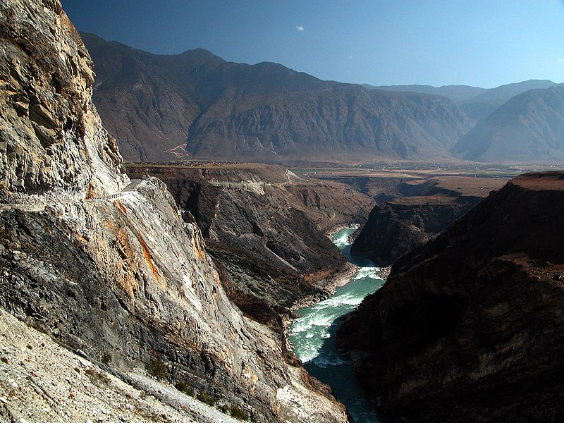
Image Credits: Wikimedia Commons.

