Slide 1


Maps
Created By: Miss K’s History
© Miss K’s History 2015

Slide 2

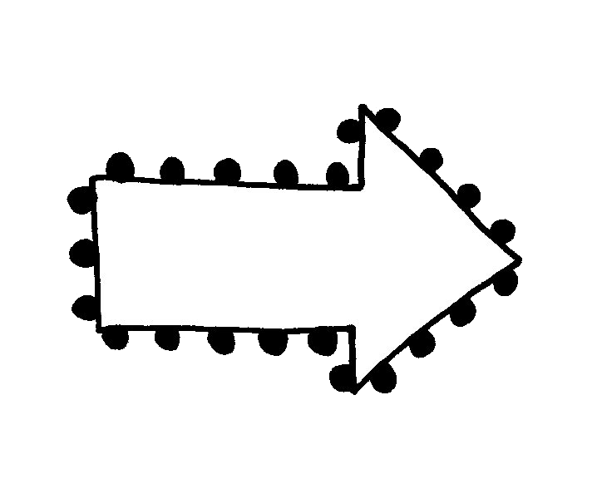

Why are maps helpful?
Shows people where things are
Can include information on population, types of land, resources, etc.
They show you how to get to places you want to go.
© Miss K’s History 2015

Slide 3
Relative Location
Location of a place in relationship to other places.
Your home has a relative location. Where is it located in relation to schools, stores, and convenient transportation?
© Miss K’s History 2015

Slide 4
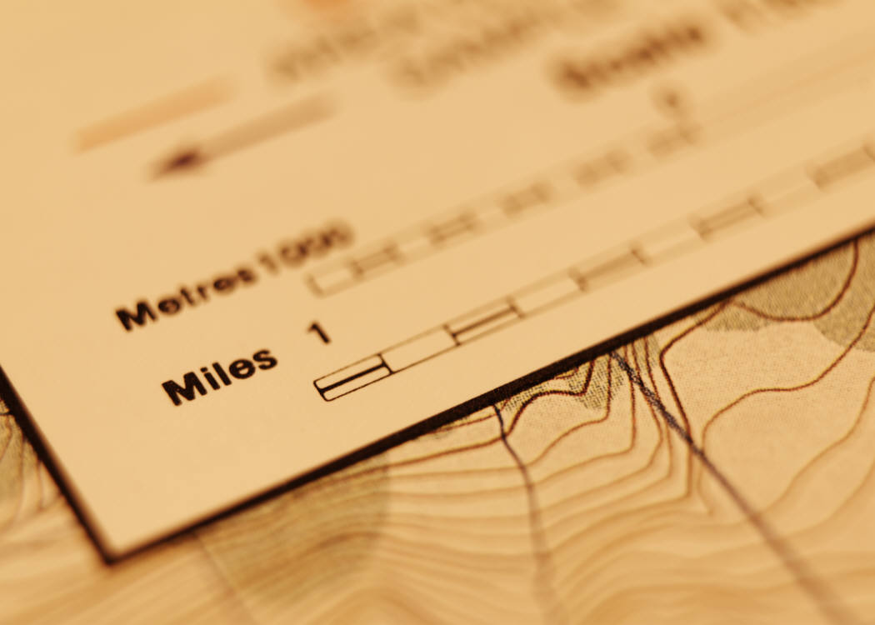
Map Scale
Allows you to measure distances between places on a map.
© Miss K’s History 2015

Slide 5

Map Scales
Shows the relationship of the distance on the land with the specific map
Example: 1-inch = 1 mile
Every map has a scale
Map Scale
© Miss K’s History 2015

Slide 6
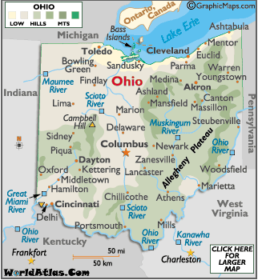
Where is the scale on this map of Ohio?
© Miss K’s History 2015

Slide 7
Key or Legend
Explains what the symbols on a map represent.
© Miss K’s History 2015

Slide 8
Keys
Also known as legends
Shows different symbols for that specific map
For example, a flower represents, “Botanical Garden” on this map
© Miss K’s History 2015

Slide 9

Compass Rose
Every map has a compass rose
Shows: North, East, South, West
Use the compass rose to give directions and find locations on a map
© Miss K’s History 2015

Slide 10

Cardinal Directions
Four main points of a compass:
North, South, East and West
Never Eat Soggy Waffles
© Miss K’s History 2015

Slide 11
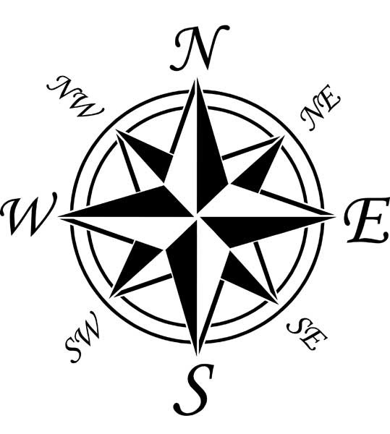
Compass Rose
© Miss K’s History 2015
NW: Northwest
NE: Northeast
SW: Southwest
SE: Southeast
All of the above are intermediate directions. Sometimes these will appear on a map too!

Slide 12
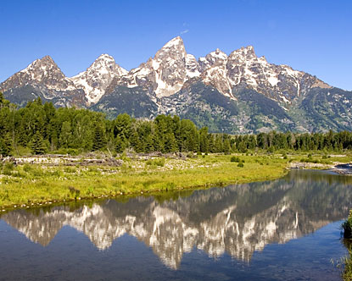
Physical and Human Characteristics
Physical: What a place is made of by nature
  Examples: Landforms, bodies of water, climate
© Miss K’s History 2015

Slide 13


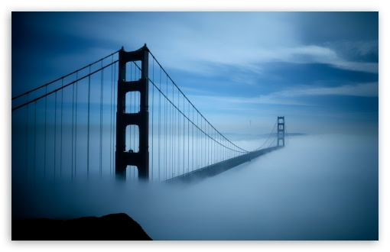
Physical and Human Characteristics
Human: Place made by humans
  Examples: Houses, bridges, parks
© Miss K’s History 2015

Slide 14

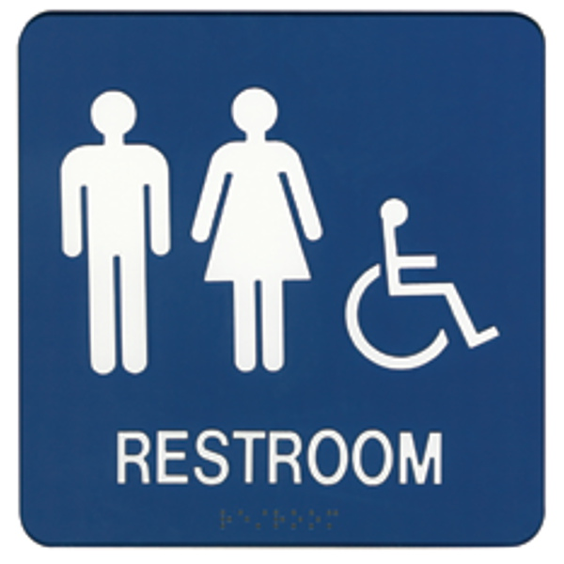
Symbols
Represents actual
places on a map
These can be restaurants, gas stations, restrooms, waterways, parks, etc.
© Miss K’s History 2015

Slide 15
What symbols do you see on this map?
© Miss K’s History 2015

Slide 16
Can you find the key on this map? The compass? The map scale?
© Miss K’s History 2015

Slide 17
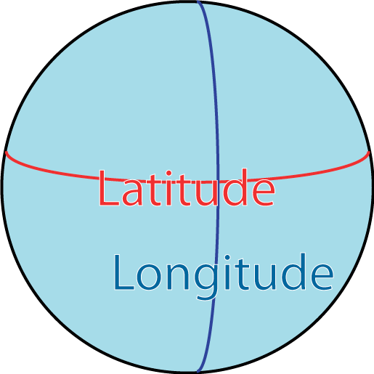
Latitude and Longitude
Latitude and longitude are imaginary lines used to identify absolute location on the earth’s surface.
Latitude and longitude lines intersect with each other creating a grid that allows us to identify the absolute location of places using coordinates.
© Miss K’s History 2015

Slide 18
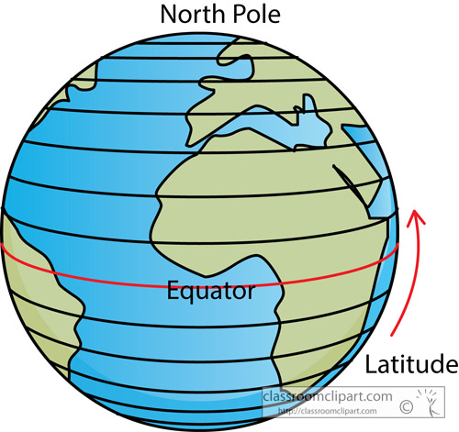
Latitude
Latitude measures distance north and south of the earth’s equator.
© Miss K’s History 2015

Slide 19
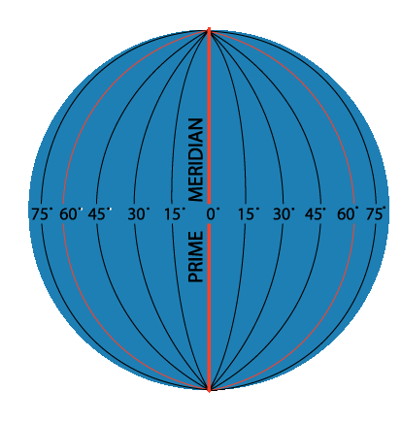
Longitude
Longitude measures distance east and west of the prime meridian.
© Miss K’s History 2015

Slide 20



Thanks to the following:
Check out their TPT stores!
Other images are hyperlinked to their website.
© Miss K’s History 2015

Slide 21
Acknowledgement and
Terms of Use
Thank you for downloading my product!
Acknowledgements and Terms of Use:
Please e-mail me at misskshistory@gmail.com if you have any questions or concerns about the product.
I love hearing your feedback!
Please take a moment to let me know how this product works for you and your students.
Please respect that this document is for one classroom only (both digital and print).
Like the PowerPoint? Download the bundle on my TPT store!
My TPT store: https://www.teacherspayteachers.com/Store/Miss-Ks-History
My Blog: http://misskshistory.blogspot.com
My Store Facebook page: https://www.facebook.com/misskshistory?ref=aymt_homepage_panel
Please note that the ideas found in this document are all the intellectual ideas of mine. Please feel free to show samples on your blog and/or classroom websites. I do ask that you credit me by linking to my TPT store.
© Miss K’s History 2015

