Slide 1
Latin America Notes

Slide 2
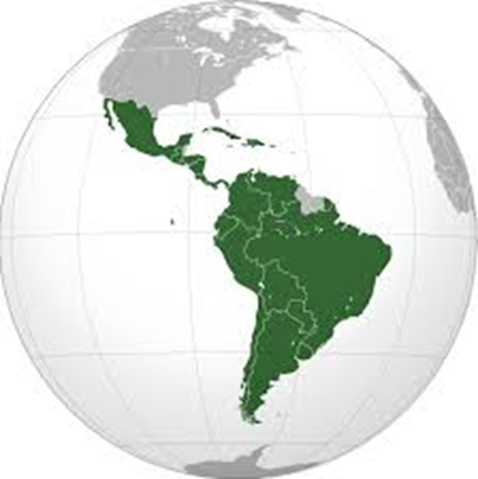
What is Latin America?

Slide 3
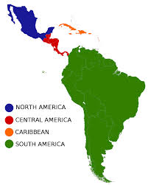
a region of the world (you won’t see it labeled
on a map or globe)
- it includes:
- Mexico
- Central America, which has 7 countries
- South America, which has 12 countries
- islands in the Caribbean Sea

Slide 4
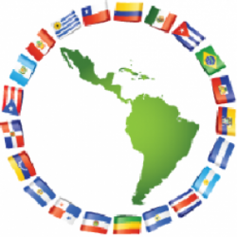
Questions about notes: answers only

Slide 5
1. Which countries are included in the term
Latin America?
A. countries that speak Latin
B. countries in North America
C. countries in Central and South America
and the Caribbean
D. countries in Central and South America
but not in the Caribbean

Slide 6
Why is it called Latin America?

Slide 7
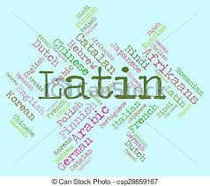
- because the languages spoken there,
Spanish and Portuguese, are Romance
languages which came from the
Latin language

Slide 8
Questions about notes: answers only

Slide 9
2. What are the 2 primary languages of Latin
America?
A. English and French
B. French and Spanish
C. Portuguese and English
D. Spanish and Portuguese

Slide 10
3. On what common language are the
languages of Latin America based?
A. Spanish C. ancient Latin
B. ancient German D. Portuguese
4. Which language category do Spanish and
Portuguese belong to?
A. Germanic C. Slavic
B. Romance D. Cyrillic

Slide 11
5. Spanish and Portuguese are important in
Latin America because they are ____.
A. the only official languages
B. the 2 main languages spoken
C. spoken by everyone in Latin America
D. understood by everyone

Slide 12
What is it like?

Slide 13
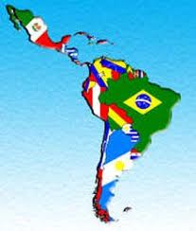
- very diverse
the countries all share similar histories and
cultures
- religion is mostly all Roman Catholic

Slide 14
Questions about notes: answers only

Slide 15
6. What is the most common religion of Latin
America?
A. Creole C. Protestant
B. Aymara D. Catholic

Slide 16
7. Which is the BEST description for the region of Central and South America, Mexico and the Caribbean?
A. The people all speak Latin.
B. The countries share similar histories and
cultures.
C. The people speak languages that come from Latin.
D. The countries share similar histories and
cultures and speak languages based on Latin.

Slide 17
8. Summary Sentence:
Three things about Latin America are _______, _________, and _________.

Slide 18
Video questions to answer:
9. % of world’s population?
10. 2 South American countries that speak Spanish?
11. where Portuguese spoken?
12. when discovered?

