Slide 1
Islam

Slide 2
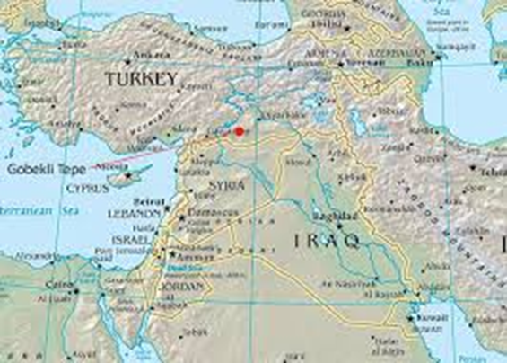
Belief – believe in only one God
Leader – Muhammad
Started – 610 AD in SW Asia

Slide 3
Name of God – Allah
Sacred Text – Koran (Qu’ran)

Slide 6
Followers called – Muslims
# of followers – about 43 million
Sacred building – mosque

Slide 7
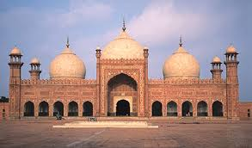

Slide 10
What happened to leader – was plot to kill
him, he escaped to city called Medina,
died when 62 (sick)

Slide 11
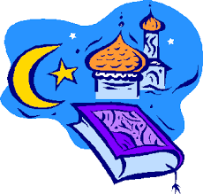
Major groups: 1. Sunnis – 90%
2. Shiites
Fun fact - fastest growing religion in
Europe

Slide 12
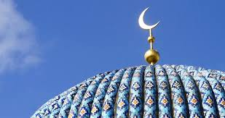
Islam Classwork
Answers only!!!

Slide 13
The leader of Islam was ______.
Where and when did Islam start?
The Islam sacred text is called a ___.
There are ______ followers of Islam in Europe.

Slide 14
5. What do they call their God?
6. Followers of Islam are called _____.
7. What are the 2 groups?
8. Which group has 90%?
9. Do they believe in 1 god or many gods?

Slide 15
10. Islam is the ____ growing religion in
Europe.
11. Why did Muhammad escape to
Medina?

Slide 16
4 corners
Which of the following is NOT true about Islam?
It’s the fastest growing religion in Europe.
There are about 53 million followers.
The sacred text is the Quran.
The leader was Muhammad.

